Slide 1

Final Project Presentation
Submitted By:
Mohit Kumar Gupta
Class: MCA ‘ C’
Group: 2
Submitted To:
Prof. Pooja Thakur
Assistant Professor

Slide 2
Problem Definition
Student Attendance
Time Wastage
Stationary Cost
Maintains Problem
Manual Work
Reputation Problem
Lake of communication

Slide 3
Objective And Description
It is designed for better interaction between students, teachers, parents & management. This management software very gracefully handles all the requirements for easy school management.
The school management system being web based can be accessed from anywhere in the world, which enables the students, teachers, parents & the management be in touch with each other at all times.

Slide 4
Functional Requirements
Hardware requirements
Processor (Minimum Core i3)
Ram (Minimum 4GB Ram)
Hard disk (Minimum 20 Gb)
Internet Connection (Minimum 2 mbps)
Software requirements
Operating system(Window, Linux ,Mac )
Visual Studio 2019
SQL Server 2019

Slide 5
Functional Requirements
School management system shall be network base.
Staff shall login.
Staff shall add new student, teacher, and class and modify them. Staff shall update school news.
Staff shall access all the data about student related.
Staff shall manage the school activity.
Staff shall generate time table.
Student shall login by his/her id.
Student shall view study activity of his class

Slide 6
Non-Functional Requirements
The system should be easy to use.
The system should be available 24 hour.
The system should response at the time
System should provide specific information to specific user.
The system should not fail.
Right information is available to right student and teacher at right time.

Slide 7
Architecture of the System
Student
Database Server
Data
Web Server
School Services Provide
Staff
Parents
HTTP Interaction
SQL Query

Slide 8
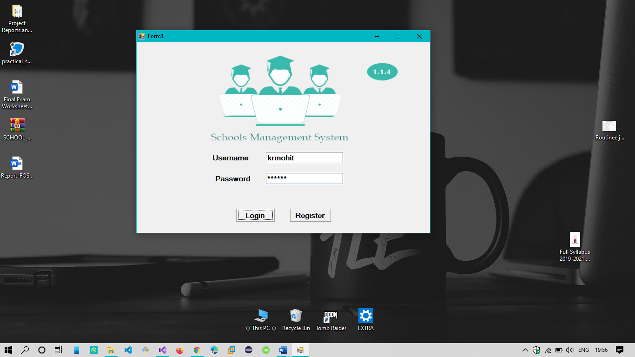
Interface Design .EXE Application View

Slide 9
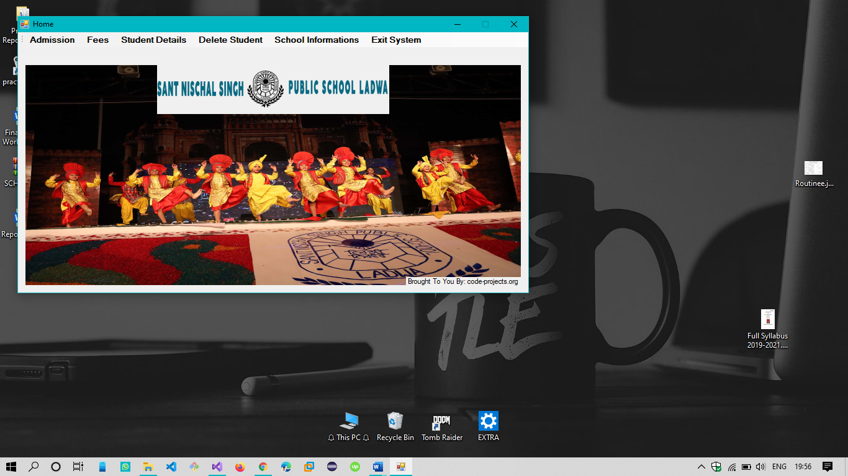
Interface Design .EXE Application View

Slide 10
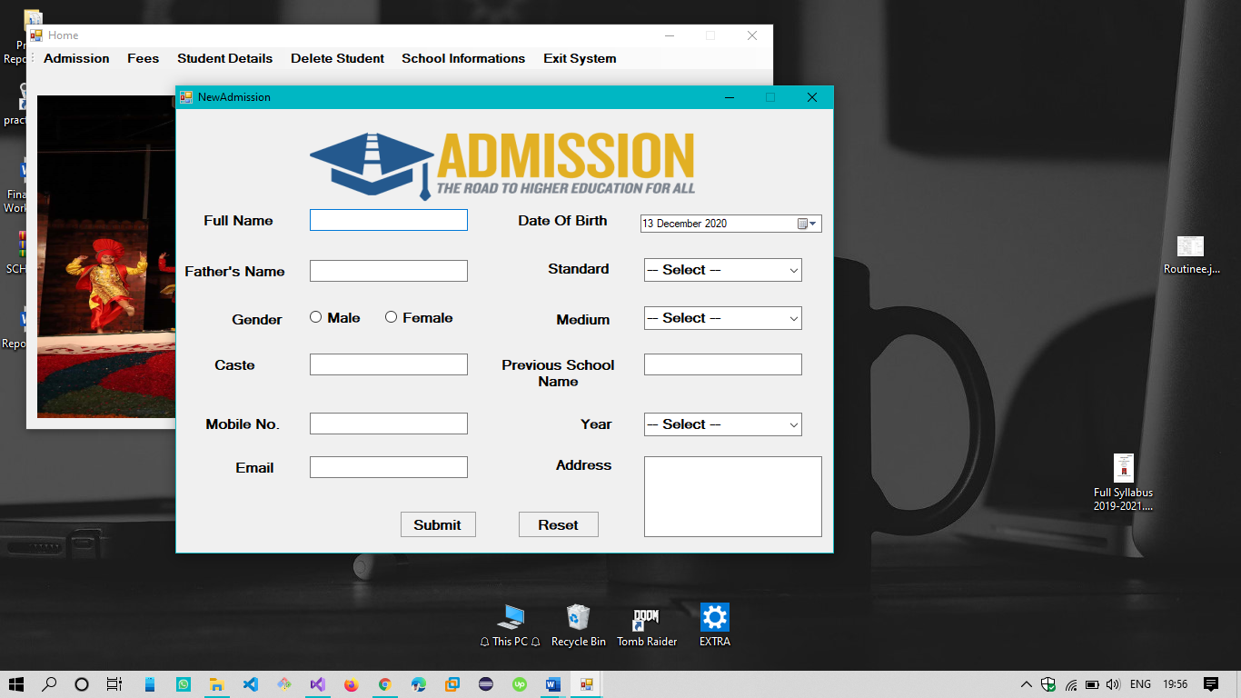
Interface Design .EXE Application View

Slide 11
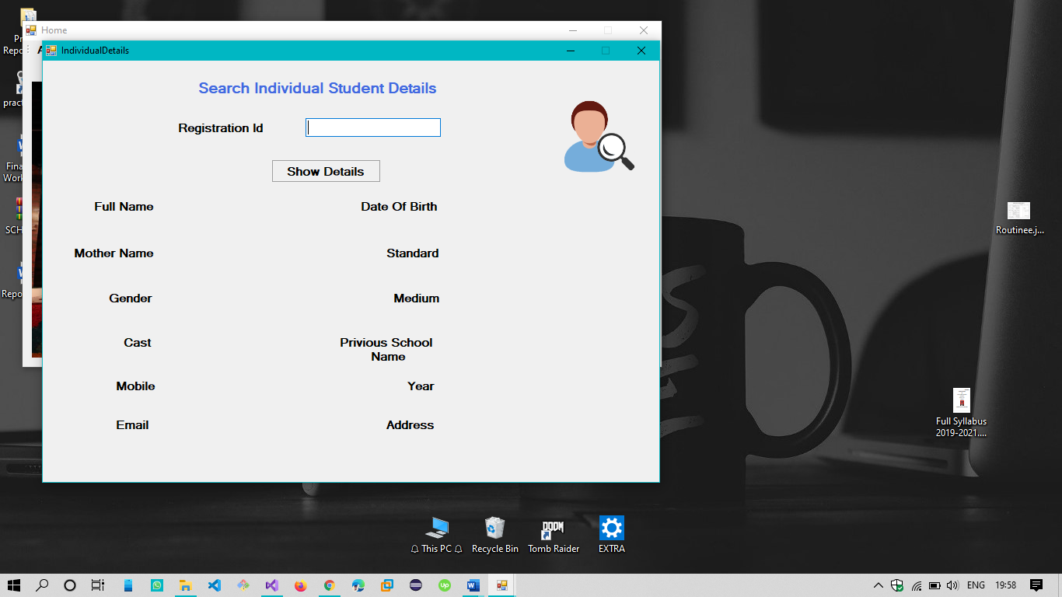
Interface Design .EXE Application View

Slide 12

Interface Design .EXE Application View

Slide 13
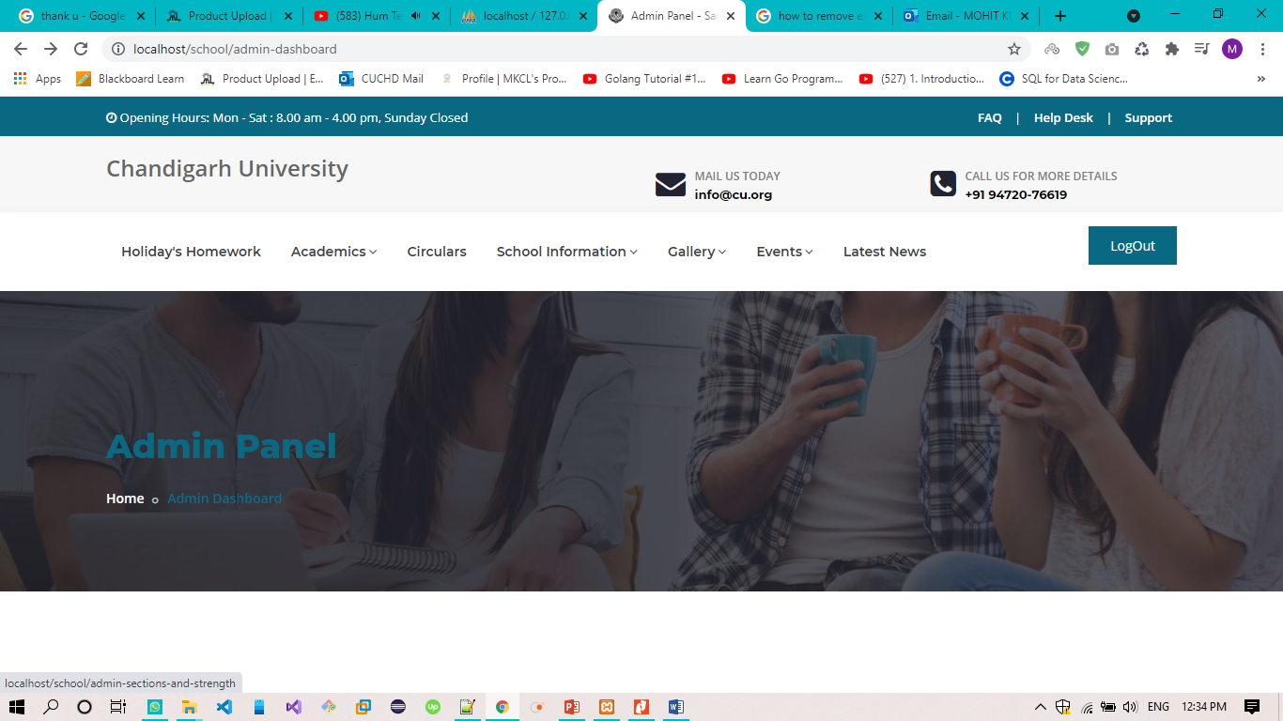
Interface Design WEB Application View

Slide 14
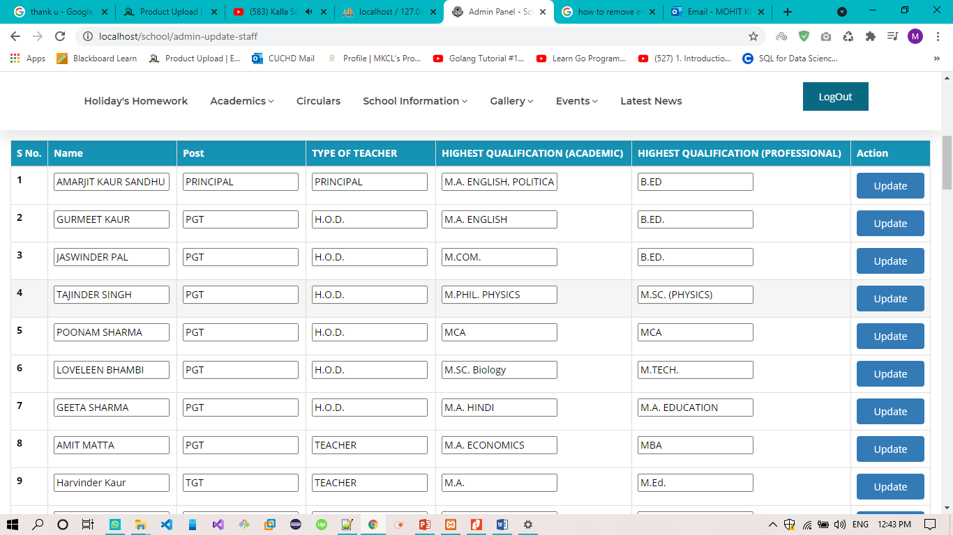
Interface Design WEB Application View

Slide 15
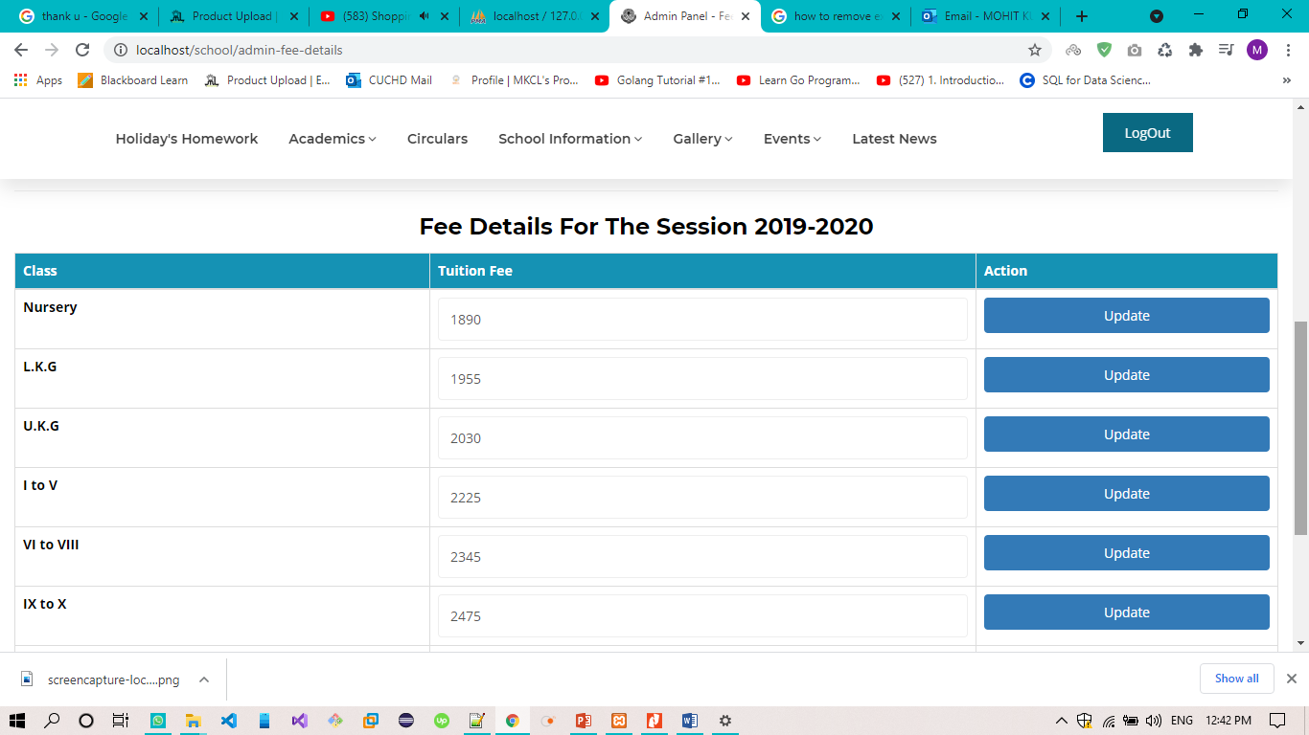
Interface Design WEB Application View

Slide 16
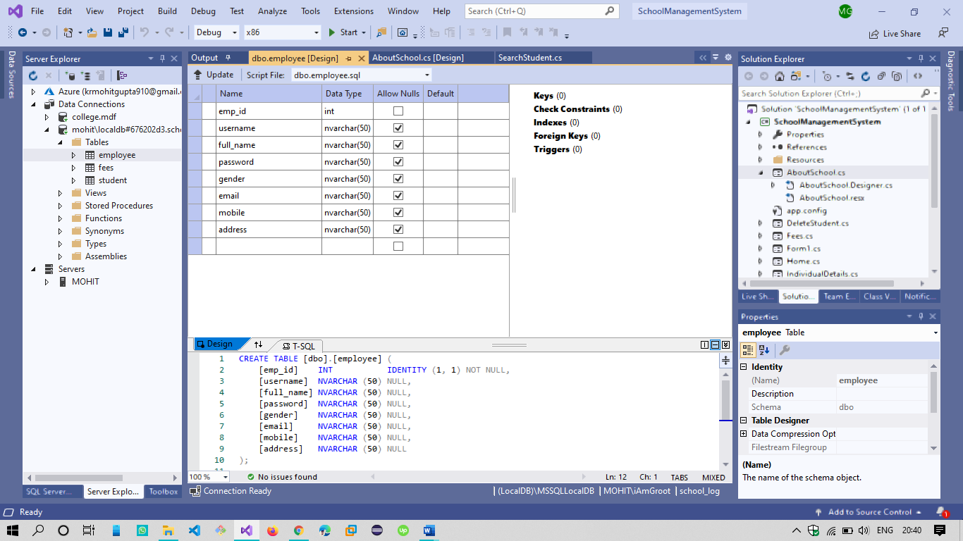
Interface Design

Slide 17
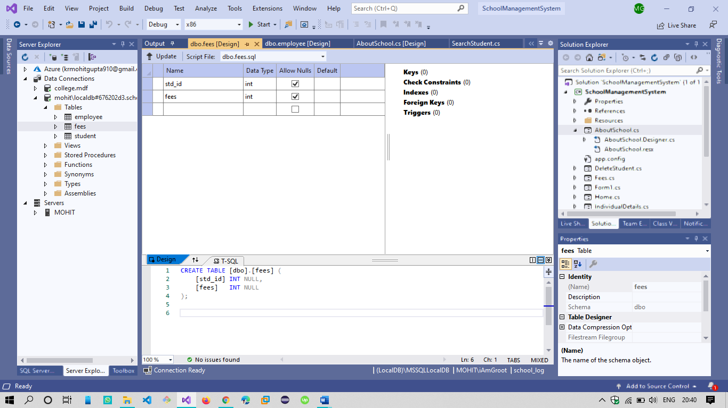
Interface Design

Slide 18
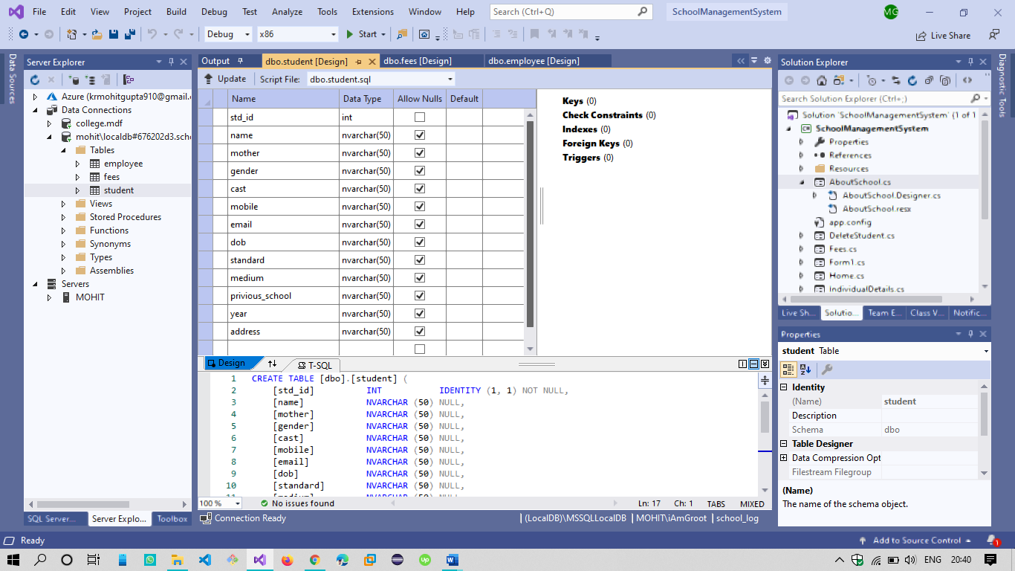
Interface Design

Slide 19

Thank You !!!

